Slide 1
Notation Part 1
Object Orientated Analysis and Design
Benjamin Kenwright

Slide 2

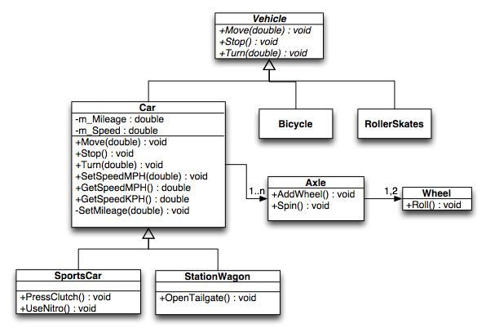
Outline
Review
What do we mean by Notation?
UML Diagrams
Examples of Notation in Analysis and Design
Summary/Discussion
Conclusion

Slide 3
Revision Question
Requirements analysis is critical to the success of a development project.
a) True
b) False
c) Depends upon the size of project

Slide 4
Answer
Answer a)
Explanation: Requirements must be actionable, measurable, testable, related to identified business needs or opportunities, and defined to a level of detail sufficient for system design

Slide 5
Question
Requirements should specify ‘what’ but not ‘how’.
a) True
b) False

Slide 6
Answer
Answer: a)
Explanation: ‘What’ refers to a system’s purpose, while ‘How’ refers to a system’s structure and behavior.

Slide 7

Diagrams
Drawing a diagram does not constitute analysis or design
However, diagrams provide visual aids
Clarifying the concept
Various forms, e.g., 3d-software, whiteboards, napkins, and the backs of envelopes

Slide 8
The Unified Modeling Language (UML)
Primary modeling language used to analyze, specify and design software systems
UML is used to model (i.e., represent) the system being built

Slide 9
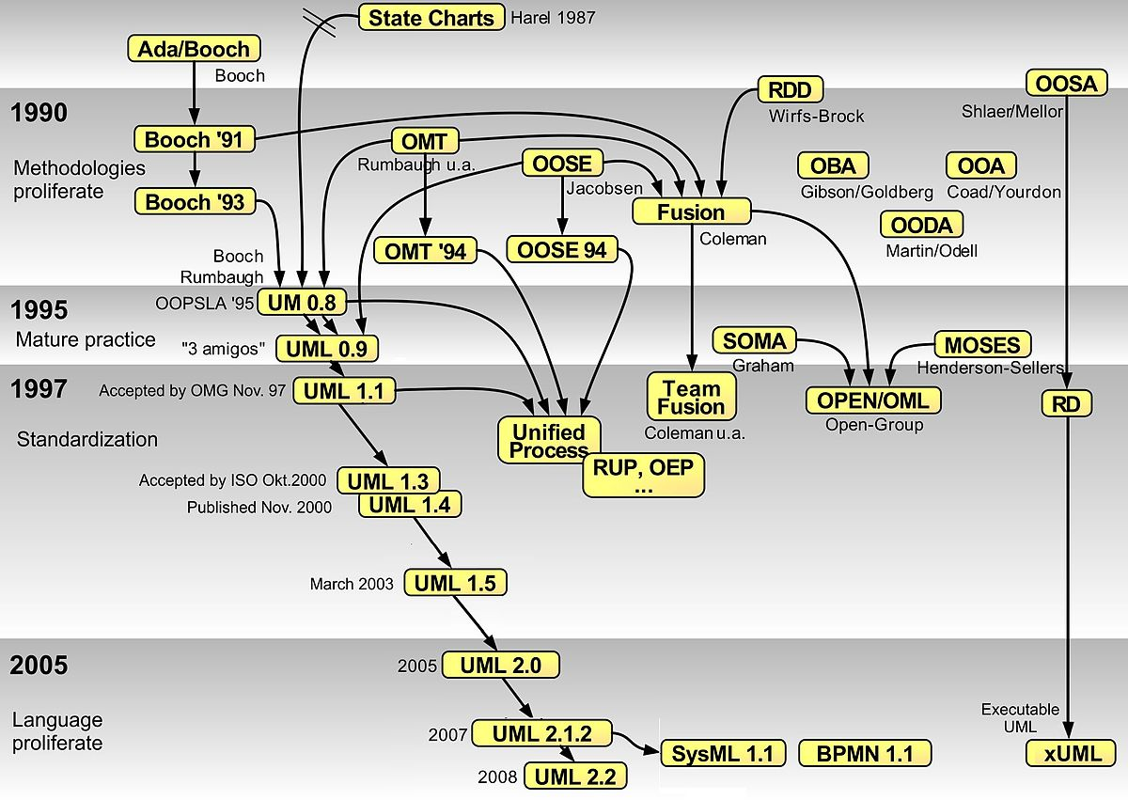

Slide 10

UML has Many Types
Of Diagrams

Slide 11
UML
Unified Modeling Language (UML): is a standardized general-purpose modeling language in the field of object-oriented software engineering. The standard is managed and was created by the Object Management Group (OMG)
UML includes a set of graphic notation techniques to create visual models of object-oriented software-intensive systems.
UML defines different types of diagrams: class (package), object, use case, sequence, collaboration, activity, component, and deployment.
UML has various types of diagrams divided into two main categories

Slide 12
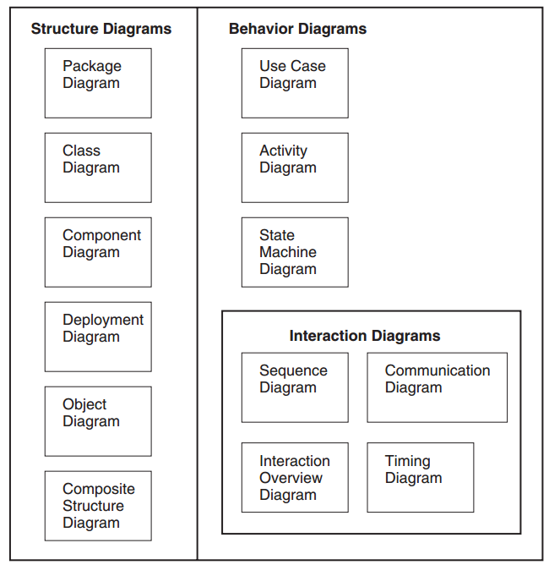
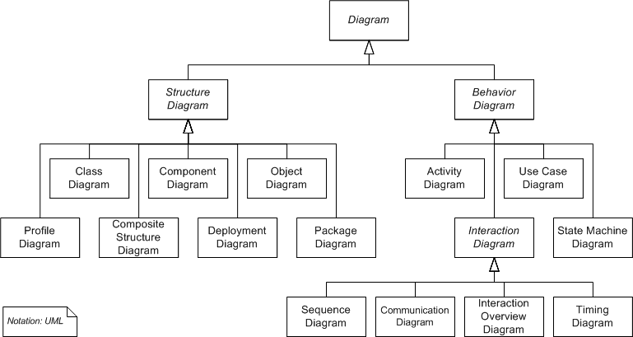
UML Diagrams

Slide 13
UML Diagrams

Slide 14
Two UML Views of System Model
Static (or structural) view: emphasizes the static structure of the system using objects, attributes, operations and relationships. It includes class diagrams and composite structure diagrams.
Dynamic (or behavioral) view: emphasizes the dynamic behavior of the system by showing collaborations among objects and changes to the internal states of objects. This view includes sequence diagrams, activity diagrams and state machine diagrams

Slide 15
Two UML Views of System Model
Structure Diagrams
Behavior Diagrams
Package Diagram
Component Diagram
Deployment Diagram
Composite Structure Diagrams
Class Diagram
Sequence Diagram
Object Diagrams
Use Case Diagram
Activity Diagram
State Machine Diagrams
Interaction Diagrams
Communication Diagrams
Interaction Overview Diagrams
Timing Diagrams

Slide 16
Question
Is a Class Diagram a static or dynamic system model view?
Static (or Structural)
Dynamic (or Behavioral)

Slide 17
Answer
Static (or Structural)

Slide 18

Activity
Write down as many UML diagram views as you can remember
Also state if they’re Static (or Structural) or Dynamic (or Behavioral)

Slide 19
Structure Diagrams
Structure diagrams emphasize the things that must be present in the system being modelled
Since structure diagrams represent the structure, they are used extensively in documenting the software architecture of software systems.
For example, the component diagram describes how a software system is split up into components and shows the dependencies among these components.

Slide 20
Behavior Diagrams
Behavior diagrams emphasize what must happen in the system being modelled
Since behavior diagrams illustrate the behavior of a system, they are used extensively to describe the functionality of software systems
As an example, the activity diagram describes the business and operational step-by-step activities of the components in a system

Slide 21
Plan
Review diagrams in an order in which one might typically develop them
i.e., instead of reviewing all the structural and then behavioral diagrams seperately

Slide 22
Package Diagrams
Package Diagrams
Component Diagrams
Deployment Diagrams
Use Case Diagrams
Activity Diagrams
Class Diagrams
Sequence Diagrams
Interaction Overview Diagrams
Composite Structure Diagrams
State Machine Diagrams
Timing Diagrams
Object Diagrams
Communication Diagrams

Slide 23
Visibility
Public (+) Visible to elements within its containing package, including nested packages, and to external elements
Private (-) Visible only to elements within its containing package and to nested packages

Slide 24
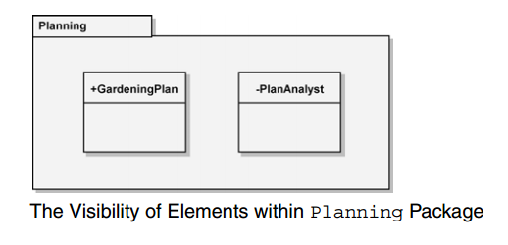
Example

Slide 25
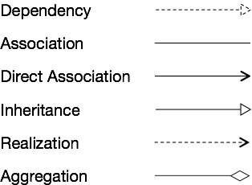
Dependencies between UML elements (including Packages)
Notations for the different types of relationships are as follows

Slide 26
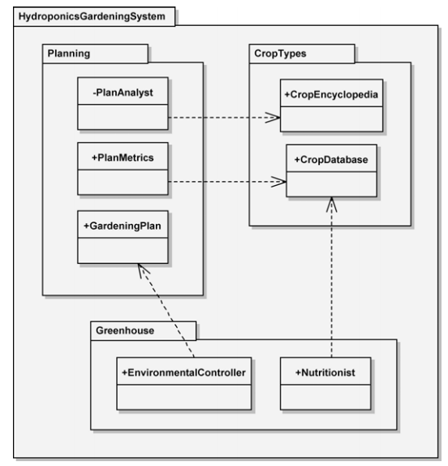
Example

Slide 27
Component Diagrams
Package Diagrams
Component Diagrams
Deployment Diagrams
Use Case Diagrams
Activity Diagrams
Class Diagrams
Sequence Diagrams
Interaction Overview Diagrams
Composite Structure Diagrams
State Machine Diagrams
Timing Diagrams
Object Diagrams
Communication Diagrams

Slide 28
Component Notation
Component is a structured classifier, its detailed assembly can be shown with a composite structure using
Parts
Ports, and
Connectors

Slide 29
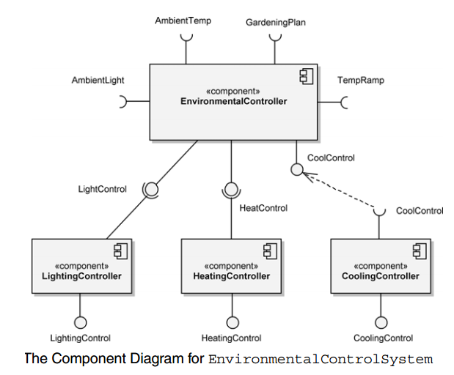
Example

Slide 30
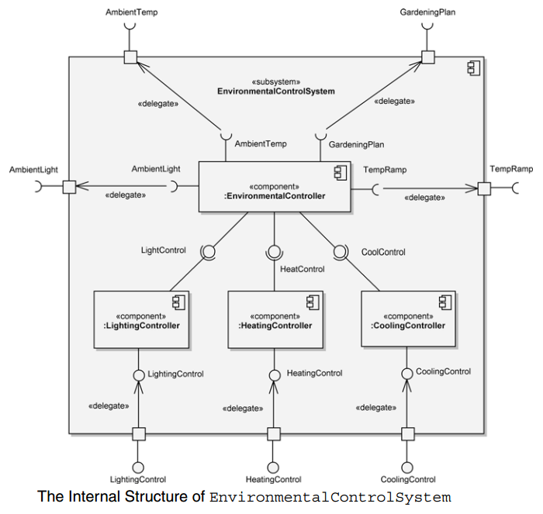
A Component’s Internal Structure

Slide 31
Deployment Diagrams
Package Diagrams
Component Diagrams
Deployment Diagrams
Use Case Diagrams
Activity Diagrams
Class Diagrams
Sequence Diagrams
Interaction Overview Diagrams
Composite Structure Diagrams
State Machine Diagrams
Timing Diagrams
Object Diagrams
Communication Diagrams

Slide 32
Deployment Diagram
A deployment diagram is used to show the allocation of artifacts to nodes in the physical design of a system.
A single deployment diagram represents a view into the artifact structure of a system.
The three essential elements of a deployment diagram are artifacts, nodes, and their connections.

Slide 33
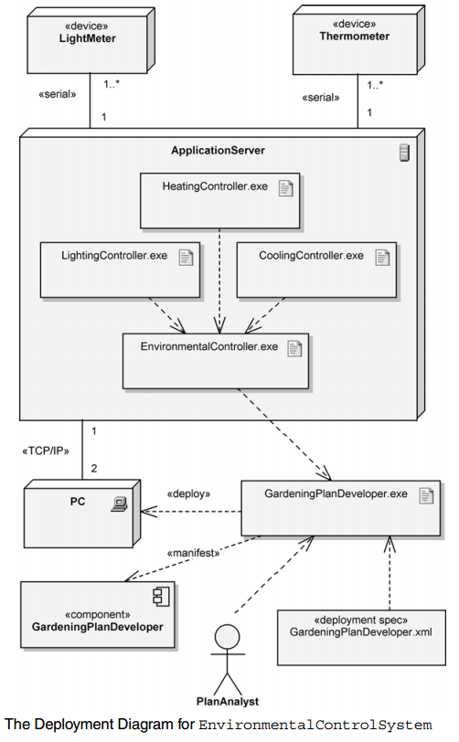
Example

Slide 34
Question
The three essential elements of a deployment diagram are:
a) nodes, connections and their elements
b) artifacts, nodes, and their connections
c) elements, relationships and connectors
d) inheritance, relationships and connectors

Slide 35
Answer
b) artifacts, nodes, and their connections

Slide 36
Use Case Diagrams
Package Diagrams
Component Diagrams
Deployment Diagrams
Use Case Diagrams
Activity Diagrams
Class Diagrams
Sequence Diagrams
Interaction Overview Diagrams
Composite Structure Diagrams
State Machine Diagrams
Timing Diagrams
Object Diagrams
Communication Diagrams

Slide 37
Use Case Diagrams
Use case diagrams are used to depict the context of the system to be built and the functionality provided by that system.
They depict who (or what) interacts with the system.
They show what the outside world wants the system to do.

Slide 38
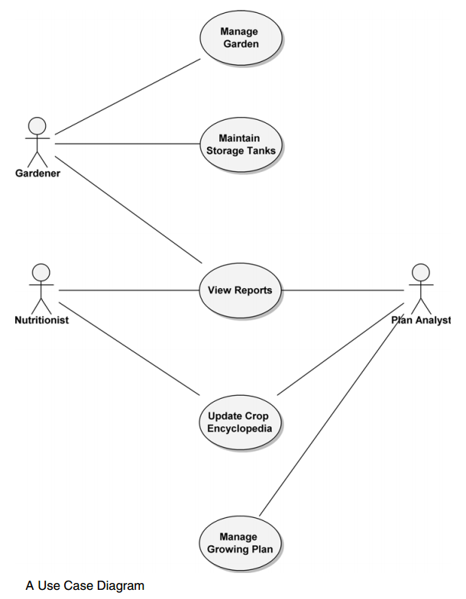
Example

Slide 39
Activity Diagrams
Package Diagrams
Component Diagrams
Deployment Diagrams
Use Case Diagrams
Activity Diagrams
Class Diagrams
Sequence Diagrams
Interaction Overview Diagrams
Composite Structure Diagrams
State Machine Diagrams
Timing Diagrams
Object Diagrams
Communication Diagrams

Slide 40
Activity Diagram
Activity diagrams provide visual depictions of the flow of activities, whether in a system, business, workflow, or other process
These diagrams focus on the activities that are performed and who (or what) is responsible for the performance of those activities.

Slide 41
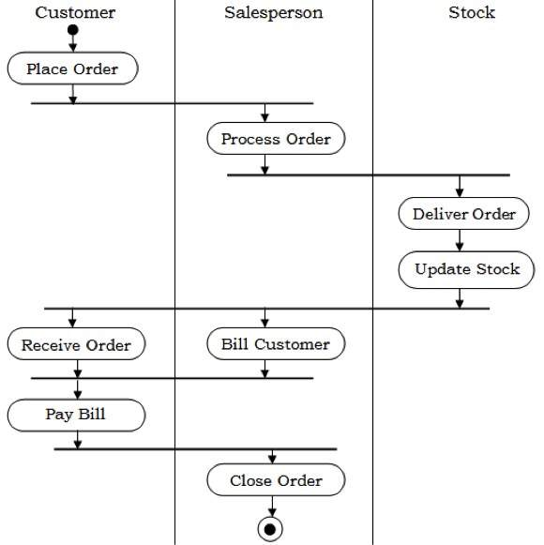
Example

Slide 42
Class Diagrams
Package Diagrams
Component Diagrams
Deployment Diagrams
Use Case Diagrams
Activity Diagrams
Class Diagrams
Sequence Diagrams
Interaction Overview Diagrams
Composite Structure Diagrams
State Machine Diagrams
Timing Diagrams
Object Diagrams
Communication Diagrams

Slide 43
Class Diagram
A class diagram is used to show the existence of classes and their relationships in the logical view of a system

Slide 44
Visibility
Public (+) Visible to any element that can see the class
Protected (#) Visible to other elements within the class and to subclasses
Private (-) Visible to other elements within the class
Package (~) Visible to elements within the same package

Slide 45
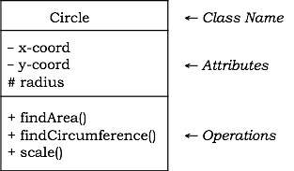
Diagrammatic Representation of a Class

Slide 46
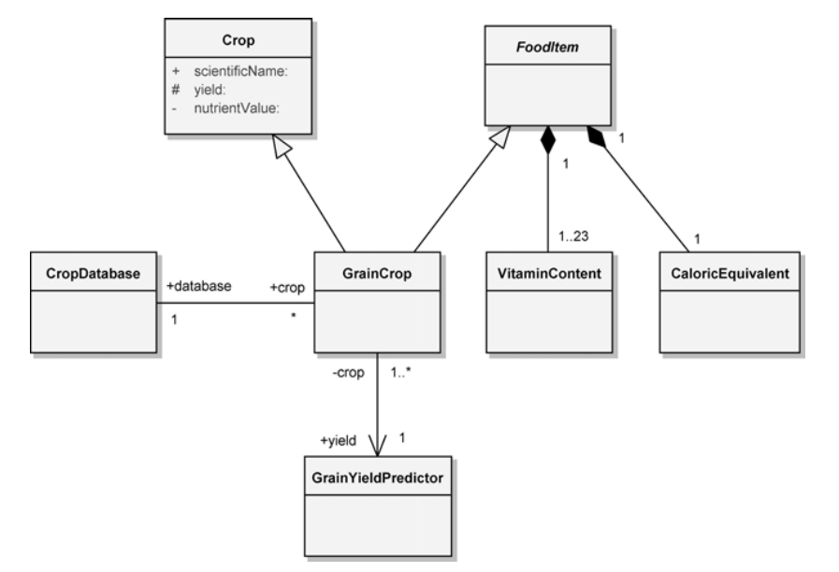
Example

Slide 47
Sequence Diagrams
Package Diagrams
Component Diagrams
Deployment Diagrams
Use Case Diagrams
Activity Diagrams
Class Diagrams
Sequence Diagrams
Interaction Overview Diagrams
Composite Structure Diagrams
State Machine Diagrams
Timing Diagrams
Object Diagrams
Communication Diagrams

Slide 48
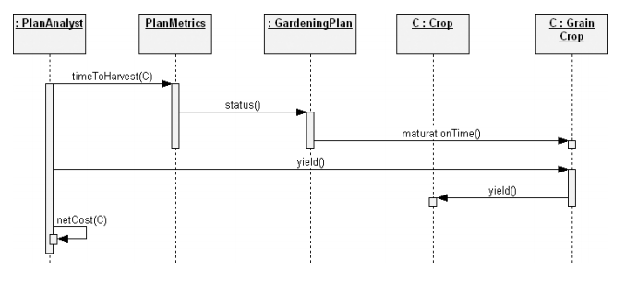
Example

Slide 49
Interaction Overview Diagrams
Package Diagrams
Component Diagrams
Deployment Diagrams
Use Case Diagrams
Activity Diagrams
Class Diagrams
Sequence Diagrams
Interaction Overview Diagrams
Composite Structure Diagrams
State Machine Diagrams
Timing Diagrams
Object Diagrams
Communication Diagrams

Slide 50
Interaction Overview Diagram
Interaction overview diagrams are a combination of activity diagrams and interaction diagrams
Intended to provide an overview of the flow of control between interaction diagram elements

Slide 51
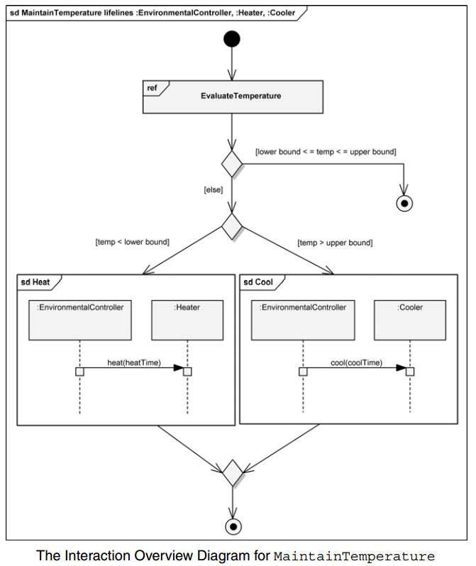
Example

Slide 52
Composite Structure Diagrams
Package Diagrams
Component Diagrams
Deployment Diagrams
Use Case Diagrams
Activity Diagrams
Class Diagrams
Sequence Diagrams
Interaction Overview Diagrams
Composite Structure Diagrams
State Machine Diagrams
Timing Diagrams
Object Diagrams
Communication Diagrams

Slide 53
Composite Structure Diagram
Composite structure diagrams provide a way to depict a structured classifier with the definition of its internal structure.
This internal structure is comprised of parts and their interconnections, all within the namespace of the composite structure.

Slide 54
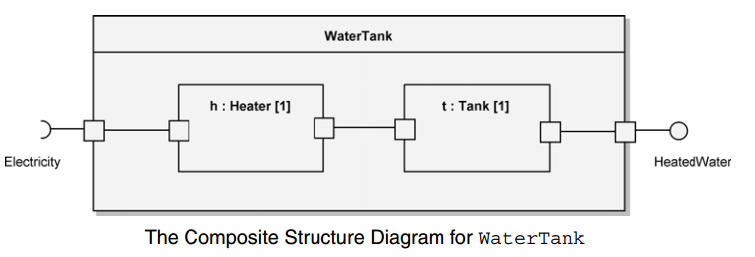
Example

Slide 55
State Machine Diagrams
Package Diagrams
Component Diagrams
Deployment Diagrams
Use Case Diagrams
Activity Diagrams
Class Diagrams
Sequence Diagrams
Interaction Overview Diagrams
Composite Structure Diagrams
State Machine Diagrams
Timing Diagrams
Object Diagrams
Communication Diagrams

Slide 56
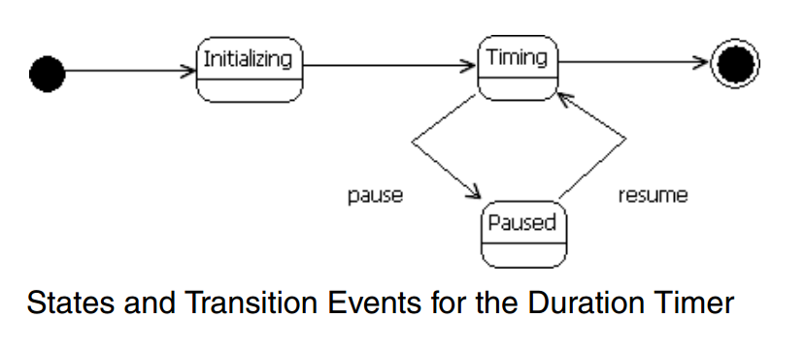
Example

Slide 57
Timing Diagrams
Package Diagrams
Component Diagrams
Deployment Diagrams
Use Case Diagrams
Activity Diagrams
Class Diagrams
Sequence Diagrams
Interaction Overview Diagrams
Composite Structure Diagrams
State Machine Diagrams
Timing Diagrams
Object Diagrams
Communication Diagrams

Slide 58
Timing Diagrams
Timing diagrams are a type of interaction diagram
Their purpose is to show how the states of an element or elements change over time and how events change those states

Slide 59
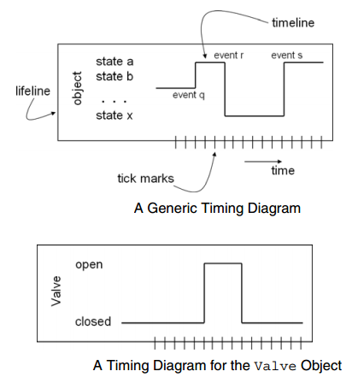
Example

Slide 60
Object Diagrams
Package Diagrams
Component Diagrams
Deployment Diagrams
Use Case Diagrams
Activity Diagrams
Class Diagrams
Sequence Diagrams
Interaction Overview Diagrams
Composite Structure Diagrams
State Machine Diagrams
Timing Diagrams
Object Diagrams
Communication Diagrams

Slide 61
Object Diagram
An object diagram is used to show the existence of objects and their relationships in the logical design of a system
Stated another way, an object diagram represents a snapshot in time of an otherwise transitory stream of events over a certain configuration of objects.

Slide 62
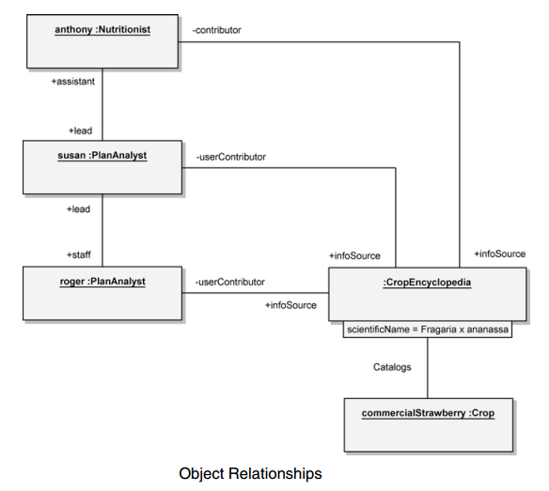
Example

Slide 63
Communication Diagrams
Package Diagrams
Component Diagrams
Deployment Diagrams
Use Case Diagrams
Activity Diagrams
Class Diagrams
Sequence Diagrams
Interaction Overview Diagrams
Composite Structure Diagrams
State Machine Diagrams
Timing Diagrams
Object Diagrams
Communication Diagrams

Slide 64
Communication Diagram
A communication diagram is a type of interaction diagram that focuses on how objects are linked and what messages they pass as they participate in a specific interaction

Slide 65
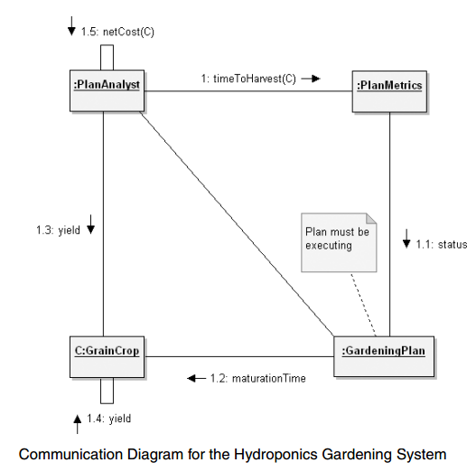
Example

Slide 66


Summary
Fundamentals of Notation in Object Orientated Analysis and Design
Specifically UML and the Different Models/Diagrams
Designing is not the act of drawing a diagram; a diagram simply captures a design

Slide 67
This Week
Review Slides
Read Chapters 5 and 6
Online Quizzes
Version Control (GitHub)

Slide 68
Questions/Discussion

